Slide 1
EMD COLORADO
Basic Anatomy

Slide 2
Introduction
Learning Goal:
To be able to identify common signs and symptoms of different patient complaints. Thus enabling the EMD provider to choose the correct treatment card and ask the appropriate questions.
Objectives:
Describe medical concepts as they relate to the EMD function.
Understand the systems of the human body and how they function.
Define Level(s) of Consciousness and how to determine them.
Define Shock, understand it’s process and how to treat it.
What really causes death?

Slide 3
Systems of the Body

Slide 4
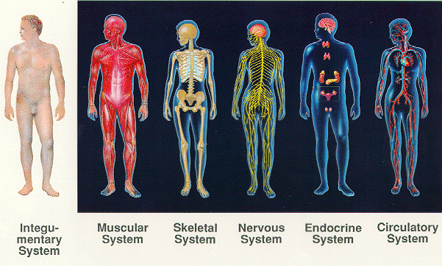
Systems of the Body
THINGS TO NOTE:
** EMD manual combines the muscular and skeleton system**
***Endocrine system is not listed.***

Slide 5
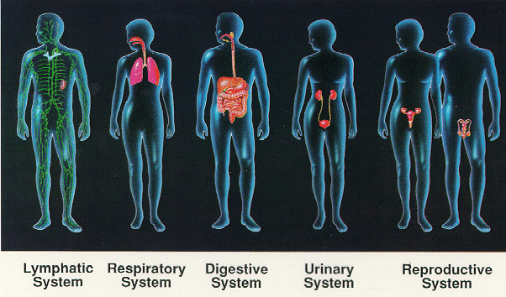
Systems of the Body (Cont.)
THINGS TO NOTE:
**Lymphatic system is not listed**
***Urinary and Reproductive systems are listed as “Genito-Urinary”***

Slide 6
Integumentary System
What’s Involved- Skin, Hair & Nails
Its Function-
As the largest organ of the body (12-15% of your body weight) it protects everything internal, maintains temperature, creates a water tight barrier.
Notes:
The epidermis is only a few skin cell layers thick
There are no blood vessels in the epidermis, if you are bleeding you have already cut down to the dermis.
Skin keeps our 70% water inside the body.

Slide 7
Muscular System
What’s Involved: Smooth, Skeleton and Cardiac Muscles
Its Function-
Provide movement, maintain posture & circulate blood throughout the body (perfusion).
Notes:
3 Muscle Types-
Skeletal Muscle- Attaches the bones to the skeleton. Made up of voluntary muscles. Move with simultaneously contraction and relaxation. All are supplied with arteries, veins, and nerves.
Arties bring oxygen rich blood to muscles, veins take depleted blood away . Under direct control of the peripheral nervous system.
Smooth Muscle or “Involuntary” muscle- Carries out the automatic work of the body. This muscle makes up most of our organs.
Cardiac Muscle- a muscle special in itself. Makes up the heart, which responds not only to an automatic system but to internal electric pulses.
Muscles can not function without oxygen rich blood. Without sufficient perfusion muscles cramp and acidic waste accumulates. Tissues become damaged and die.

Slide 8
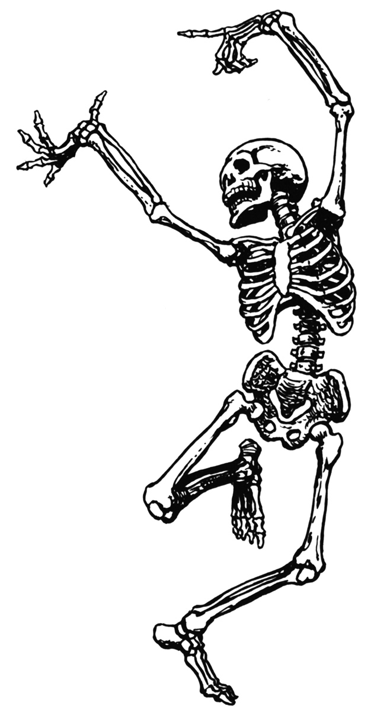
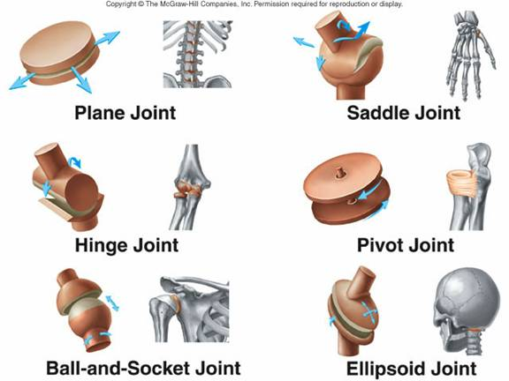
Skeleton System
What’s Involved- Bones (206 to be exact)
Its Function-
Support, movement, protection, production of blood cells, and storage for the endocrine system.
Notes:
We are born with 270 bones, which solidify over time to 206. We reach this around age 30.
Protection- Skull protects the brain, ribs protect the lungs heart and blood rich organs like the liver and spleen. The spine protects the spinal column though its intricate lace like structure that allows movement.
Largest bone in the body? Femur. When broken the quad muscles are so strong the leg can shorten by several inches with out the structural integrity of the femur. This causes possible severation of the Femoral Artery.

Slide 9
Notes:
Cranium or skull- hole at the bottom is the foramen magnum
Note on the eyes- made of a jelly like substance called vitreous humor, once is comes out it can not be replaced. Never apply pressure to an eye injury
Mandible is the only part of the skull that should move. If something else is moving, its broken. The skull is made up of several small fragile bones. Applying direct pressure can push these bones into the brain. Use extreme caution when controlling bleeding with head trauma.
Spine- bend you head forward at the base of the neck you will feel a bump that is c-7.
C-1 Atlas (holds the weight of its world on it’s shoulders)
C-2 Axis. Allows the head to pivot on and axis.
Your spine is made up of 33 vertebrae total.
12 in thoracic linked to your 12 ribs
5 in the lumbar. Common ailments include herniated disks. There is a disk between each vertebra that acts as a cushion, allows movement, but not too much as we don’t hurt the spinal column. It is made of toothpaste like substance. Once it breaks its barrier is cant go back in, and will cause pressure on nerves. Specifically the sciatic which can cause pain radiation down the leg to foot.
The diaphragm is connected to the lumbar vertebrae
Sacrum. 5 fused disks. These can have cysts in the plural space.
Coccyx (4) can result in a broken tail bone
Sprain VS Strain-
Sprain- Is injury to ligament and thus the joint
Strain- Is an injury to muscle or tendon.
Vocabulary-
Tendons- Connect muscle to bones
Ligaments- Connect bones to bones
Joints- Where bones meet
Strain Vs. Sprain

Slide 10
Nervous System
What’s Involved-
Central Nervous System- Brain & Spinal Cord
Peripheral Nervous System-Outside Nerves to Limbs and Organs
Its Function-
Detect and process sensory information & activate bodily responses.
Notes:
Automonic Nervous System- Involuntary. Couldn’t control it if you wanted to. IE Lungs, digestive system, kidneys.
Spinal cord is the extension of the brain. Carries messages from the brain to the rest of the body.

Slide 11
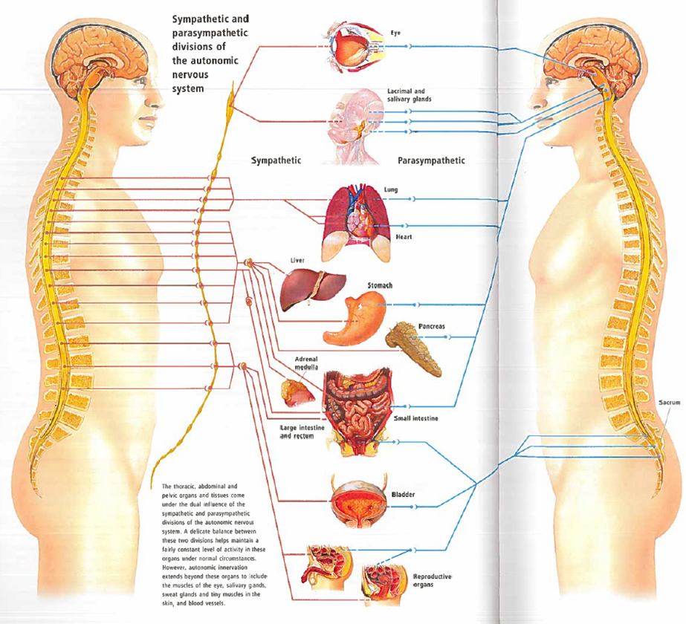
Breaking the System

Slide 12
Circulatory System
What’s Involved- Pump, Pipes & Fuel
Its Function-
Perfusion- The circulation of blood within an organ or tissue in adequate amounts to meet the cell’s current needs.
Notes:
It’s entirely closed system whose sole purpose is perfusion-
Arteries vs veins. Bleeding from artery vs vein
Blood is made up of red blood cells, white blood cells, plasma, platelets and proteins. Normal adult has 5 liters of blood in their body. You body can only process 1 liter of water per hour.
Blood pressure- Normally is 120/80. Systolic over diastolic. Systolic is when the heart is contracted and reaches the highest pressure against the arteries. Diastolic is when the heart is at rest. High blood pressure means higher chance of rupture of little vessels, more chance for clotting. Strokes and heart disease usually go hand and hand with high blood pressure.
Blood comes out of the heart from the aorta- largest artery in the body, and into the heart from the superior vena cava, these pipes are lodged deep, deep inside the center of our body for protection. They can be severed by severe trauma, such as car crashes, and AAA.
Circular System also maintains temperature, along with skin. The brain does not like to be over 105 degrees. Think- Febrile seizures. There is a debate whether febrile seizures happen when the fever is at it’s peak, or after the fever breaks.

Slide 13
Video of Circulatory System
Notes:
How blood travels through the heart. Blood enters from the superior vena cava into right atrium, passes through valve to right ventricle. The blood then exits the heart through the pulmonary arteries to the lungs. Gets reoxygenated, travels from the lungs back to the heart into the to left atrium, to left ventricle and out the aorta to the rest of the body.
As blood passes through the organs (muscles) it brings in oxygen and nutrients, takes out cellar waste and carbon dioxide. This exchange happens in the capillaries. Waste goes to the kidneys and liver.

Slide 14
Blood Thinners/Anticoagulants
Common Types
Aspirin (includes baby)
Ibuprofen
Coumandin (Warfarin)
Plavix
Lovenox
Heparin
Notes:
Fibrin creates clots, made of 20 different plasma proteins. Vitamin K plays a large role in this.
When the body is cut the veins and arteries contract to make up for the loss in volume. Fibrin attempts to clot the cut.
Clotting- When someone cuts themselves we elevate, apply direct pressure and keep adding clean bandages to the soaked ones. It takes 6-10 mins for a good clot to form. If the bandage is removed all the hard work of the fibrin is destroyed.

Slide 15
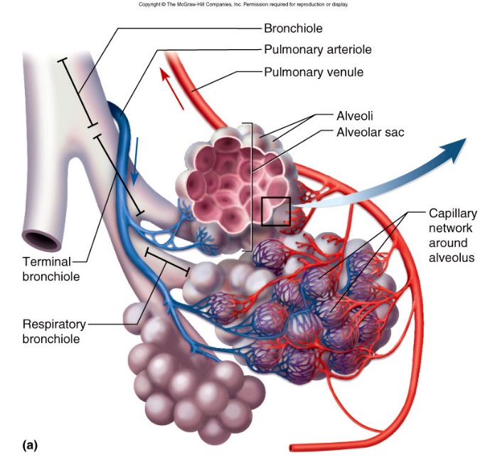
Respiratory System
What’s Involved- Upper & Lower Airways
Its Function-
Move oxygen in, move carbon dioxide out.
Notes:
Involves all structures of the body that relate to breathing.
In EMS A.B.C is vital- Airway always comes first. Without Oxygen circulated blood is useless. It just circulates waste through out the body which kills muscle tissue.
Larynx is your voice box
Diaphragm in the only organ in the body that is both involuntary and voluntary. Lungs can not expand themselves as they have no muscle. They rely on the diaphragm to open the thorastic cavity, and with negative pressure fill the lungs (See Video).
Inhaling is the active part of breathing, that’s what takes work.
The brain stem controls our breathing c1/c2/c3. The brain stem tracks the level of CO2 in our system not oxygen. When c02 levels get to high, the brain stem sends impulses down to your diaphragm and inter costal muscles and makes you breath harder. This back up system is called the hypoxic drive.
The lungs are made up of 700 million grape like sacs called alveoli. The oxygen exchange occurs in the alveoli in the Pulmonary capillaries.
All cells in the body need a steady supply of oxygen to survive. Some need a constant supply like the cardiac muscle. If the heart does not receive oxygen it’s cells start dying immediately. Your brain cells start to die when deprived of oxygen for 4-6 mins.
Breathing Normally-
EASY
Normal rate and death
Regular rhythm
Good breath sounds
Regular rise and fall of the chest
Movement of ABD
Babies are nasal breathers, so when their noses get clogged they will act like they cant breathe. Clear the nostrils out, they usually are fine.
Irregular Breathing-
Agonal Breathing- Desperate gasping- inadequate, breathes are too shallow to sustain life
Wheezing, rhales, rhonchi.
2-3 words sentences
Tripoding
Chocking is respirtory distress

Slide 16
Animation of Breathing

Slide 17
Digestive System
What’s Involved-
Its Function-
To process food and nourish the individual cells in our body.
Waste Removal.
Notes:
It takes a lot of blood to digest food, the abdominal area is filled with blood vessels, and nerves which can cause a lot of pain when things are not working properly.
The abdomen is notorious for causing “referred pain” Or pain somewhere else in the body, not in the problem area. IE- Gallstones pain can radiate to the right shoulder. Pancreatitis to the spine.
Food comes in from your mouth to esophagus to stomach, then through your duodenum to the small intestines to the large, and out the rectum/anus.
From the moment found enters your mouth enzymes start processing your food into sugars, fatty acids, and amino acids. The basic products of digestion are carried through the walls of the large intestines, and through the main artery in the liver.
About 7% of you body weight passes through your digestive system a day. Image how dehydrated you can be after 2 days of vomiting and diarrhea.
Which organs are solid, which organs are hollow?
Solid or blood filled-Liver, Spleen, Pancreas, Kidneys
Important organs like the spleen and liver are protected by the rib cage, but if the 11/12 ribs breaks you can be sure there is spleen/liver damage. Which can rupture usually a few days later
Hollow- stomach, gall bladder, intestines, bladder.
Kids vs. handle bars- Common pancreas injuries. The pancreas is so well buried and protected inside the body (next to the aorta and vena cava) its nearly impossible to injure. Common injuries include kid vs handle bars of bikes, horse kick to the stomach. These sheer forces severs the pancreas in half.
.

Slide 18
Endocrine System
What’s Involved- A complex message and control system that integrates many body functions.
Its Function-
Releasing hormones such as adrenalin and insulin into the body. Regulate body processes.
Urinary System-
Controls water balance in the body, removes waste from blood.
Reproductive System- Reproduce.
Notes:
Each endocrine gland has a different hormone and different hormones are used for different things.
Example- flight or flight response. Releases adrenaline or cortisol, which increases our heart rate and blood pressure. This puts us into a stimulated state with high levels of alertness.
If digestive system is in the front of the body, the endocrine or renal (urinary system) is in the back. Kidneys are set in the back, and the pancreas is deep in the body so I doesn’t get injured.
Pancreas and kidneys are solid organs. The pancreas releases insulin which allows cells to absorb sugar or energy. Hypoglycemia vs. hyperglycemia
20% percent of the bodies blood flow passes from the heart through the kidneys each minute.

Slide 19
Level of Consciousness
Things you may hear-
-A&0 4/4-
Alert and orientated to person, place, time & environment.
As mental status decreases the top number changes i.e.-
Pt only knows their
own name- A&O 1/4
-Altered Mental Status-
Not Acting Right

Slide 20
SHOCK!!!
Notes:
Cases- Medical VS. Trauma.
EMS arrives on scene and immediately decides Sick VS. Not Sick

Slide 21
What is shock?
SHOCK- A complex sequence of events leading to crash of circulatory system.
What does this mean-
If there is no oxygenated blood going to organs, waste builds up, cells die and organs die.

Slide 22
What Causes the Human Body to go into Shock?
One of the 3 parts of the cardiovascular system becomes distressed or is disrupted.
(Pumps, Pipes & Fluid)
3 Stages of Shock-
Compensated- The body can compensate for blood loss.
Decompensated- Blood pressure begins falling to lack of blood in pipes. Organ systems shut down to shunt blood to the heart. This leads to vital organs being denied oxygen which leads to organ death.
Irreversible shock- The body can no longer compensate for loss of blood. At this stage there is no medical intervention that can help. Death is imminent.
Notes:
During shock the body diverts blood from areas that can tolerate low blood flow (skin, intestines, limbs) to organs that need it (Heart, brain, lungs)
Note on bleeding: Per EMD protocol- no tourniquets, too many variables. Really have to be on scene and see where to place them. But due to the Iraq war they are coming back into the EMS field.
If a tourniquet is already in place leave it on.
Special NOTE- Children vs, adults. When a child is in shock they area the little engine that could until they cant. Their vital signs will plateau and remain stable, until the crash. Once they crash it is very hard to bring them back. A this stage, death in children is very common.

Slide 23
What are the different types of Shock?
Cardiogenic- Inadequate function of the heart or “Pump” failure.
Respiratory Insufficiency- Caused by a severe chest injury, or obstruction leads to loss of oxygen in the blood, “Fuel” problem
Hypovolemic- Loss of fluid or blood creating a “Fuel” problem.
Anaphylactic- The body’s extreme reaction to a foreign protein or other substance. Blood vessels dilate causing a “Pipe” problem.
Neurogenic- Damage to the spinal cord which causes the blood vessels to dilate causing a “Pipe” problem.
Some brain conditions can cause this as well
Septic- Extreme infection damages vessel walls causing leaks and poor perfusion creating a “Pipe” problem.
Psychogenic (fainting)- General vascular dilation due to stress or a “Pipe” problem
Anaphylactic shock-

Slide 24
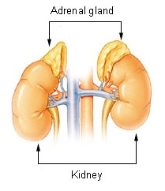
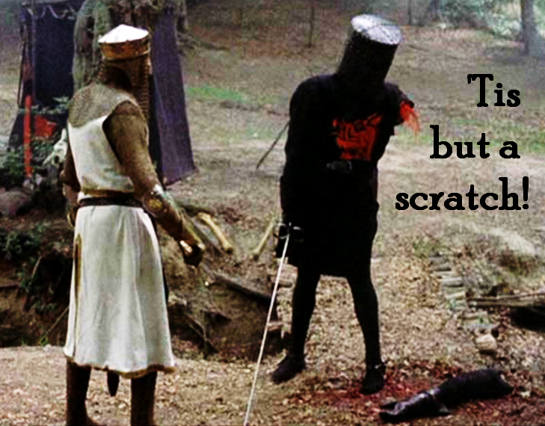
What Does SHOCK Do to the Body (Cont.)?
Integumentary System-
Pores Dilate, opening and releasing sweat. Blood is redirect from skin creating a cold clammy feeling.
Digestive System-
Blood flow to the digestive system stops (large and small intestines, stomach) causing nausea and vomiting.
Endocrine System-
Releases adrenaline and cortisol prompting your flight or fight response. This also causes sweating, agitation, anxiety, increased heart rate and respiratory rate. Can create improper reactions to the situation.

Slide 25
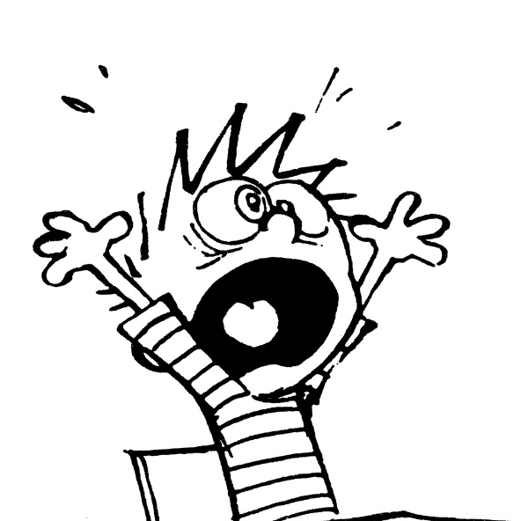
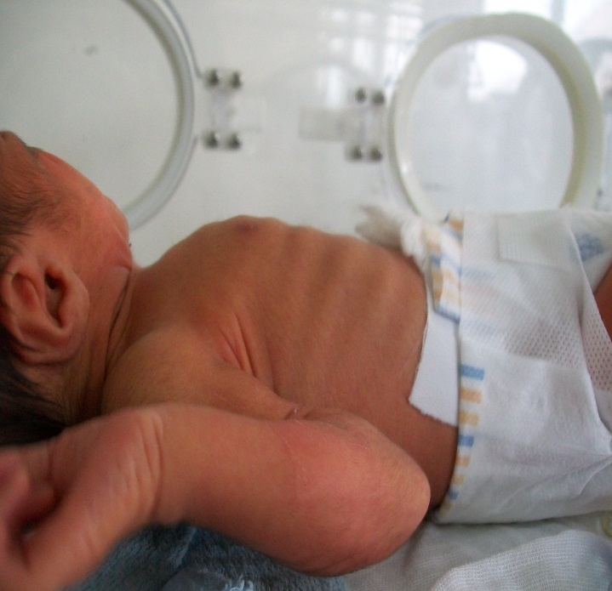
What Does SHOCK Do to the Body (Cont.)?
Nervous System-
Adrenaline causes agitation, anxiety
Blood pulled from brain creates confusion or an altered mental state
Feeling “faint” or loss of consciousness
Respiratory System-
Increased Respiratory Rate
Respiratory Distress, possible use of intercostal muscles, tri-poding.
Circulatory System-
Vessels contract to compensate for blood loss, this increases BP.
Heart becomes distressed- heart rate can increase or decrease depending on type of shock, rhythm may be effected.
The heart will continue to function till electric impulse is compromised or lack of oxygen from blood
Notes:
Put them in shock position, to help blood get to brain.

Slide 26
Signs & Symptoms of Shock
Compensated Shock-
Agitation
Anxiety
Restlessness
Feeling of Impending Doom
Altered Mental Status
Weak, Rapid (thready) pulse
Clammy/Diaphoretic (pale, cool, moist) Skin
Pallor, with cyanosis around the lips.
Shallow, Rapid breathing
Short of Breath
Nausea or Vomiting
Capillary Refill Longer than 2 secs.
Marker Thirst
Decompensated Shock
Falling Blood Pressure below 90 Systolic
Labored, Irregular Breathing
Ashen, Molten Skin
Thready or Absent Peripheral Pulses
Dull eyes, Dilated Pupils
Poor Urinary Output

Slide 27
How to treat for Shock
Maintain Airway
Control Bleeding (if possible)
DO NOT GIVE ANYTHING TO EAT OR DRINK
Stay Calm, reassure the patient, treat gently
DO NOT MOVE TRAUMA Pts (spinal injuries)
Lay patient on back, raise legs 10-12”
Keep the patient warm

Slide 28
RESOURCES
EMD of Colorado Instructors Manual
EMD of Colorado 911 Center Book
Anatomica, The Complete Home Medical Reference, Global Book Publishing
Emergency Care & Transport of the Sick & Injured, AAOS. 9th Edition.

Slide 29
Aleta Fantoni EMT

